Slide 1
Chapter - Three
The Time value of money
numerical =5 to 10 marks

Slide 2
Concept of Time Value of Money
Time value of money is one of the most important concepts in finance. It means that the value of a rupee received one year from now is not the same as the value of a rupee received today.
The time value of money is the concept that money available at the present time is worth more than the same amount of money in the future, due to its potential earning capacity through interest or investment.
The money it now has can be invested and earn positive returns.
Time is money.
Time value of money can be clearly defined as the relationship between time and value of money.
Time value money is also called 'mathematic of finance'
"The time value of money deals with the fact that an amount of money received in the future is not as the valuable as the same amount of money received in the present”

Slide 3
Significance (Importance) of Time Value of Money)
Time value of money concept is important for following reasons
1. Valuation of securities and other assets:-
The value of any assets is the present value of the expected future cash flows( interest and dividend)
For investor as well as financial manager, it is useful to make the valuation of the assets.
2. Capital budgeting or Analysis of investment projects:-
Capital budgeting is the process of evaluating and selecting the investment project.
For the investment decision, time value of money is very important to convert the future cash flow in the present value of term.
3. The cost of capital:-
Company needs the capital for long term investment. For this purpose, it is necessary to calculate the cost of capital of long term investment
For the calculation for cost of capital time value of money concept is important.

Slide 4
4. Working capital management: -
All firm needs working capital for daily operations.
To manage working capital of the firm, time value of money is important.
5. Lease analysis:-
Company needs fixed assets to generate sales. Company can purchase or lease the fixed assets.
For this analysis of lease Versus purchase decision time value of money is important.

Slide 5
Cash flow Time line
A cash flow time line is a visual representation of the timing and amounts of cash flows for a given financial transaction. It is typically presented as a horizontal line with the periods in which cash flows occur represented by vertical lines or arrows. The cash flow time line is used to determine the present and future values of cash flows and to evaluate investment opportunities.
The time line is a horizontal line divided into equal periods such as days, months or years.
Each cash flow, such as a payment or receipt, is plotted along this line at the beginning or end of the period in which it occurs.
To illustrate the time line concept, consider the following diagram:
Time 0 1 2 n
interest rate i= ……. ……… ……….
Cash flow Cfo Cf1 Cf2 Cfn
present value(PV) Future value =

Slide 6
Methods/Techniques of Time Value of Money
A. Single Cash Flow (Lump Sum cash flow) Method
B. Multiple Cash Flows Method
C. Present value of perpetual cash flows
D. Uneven cash flows annuity methods

Slide 7
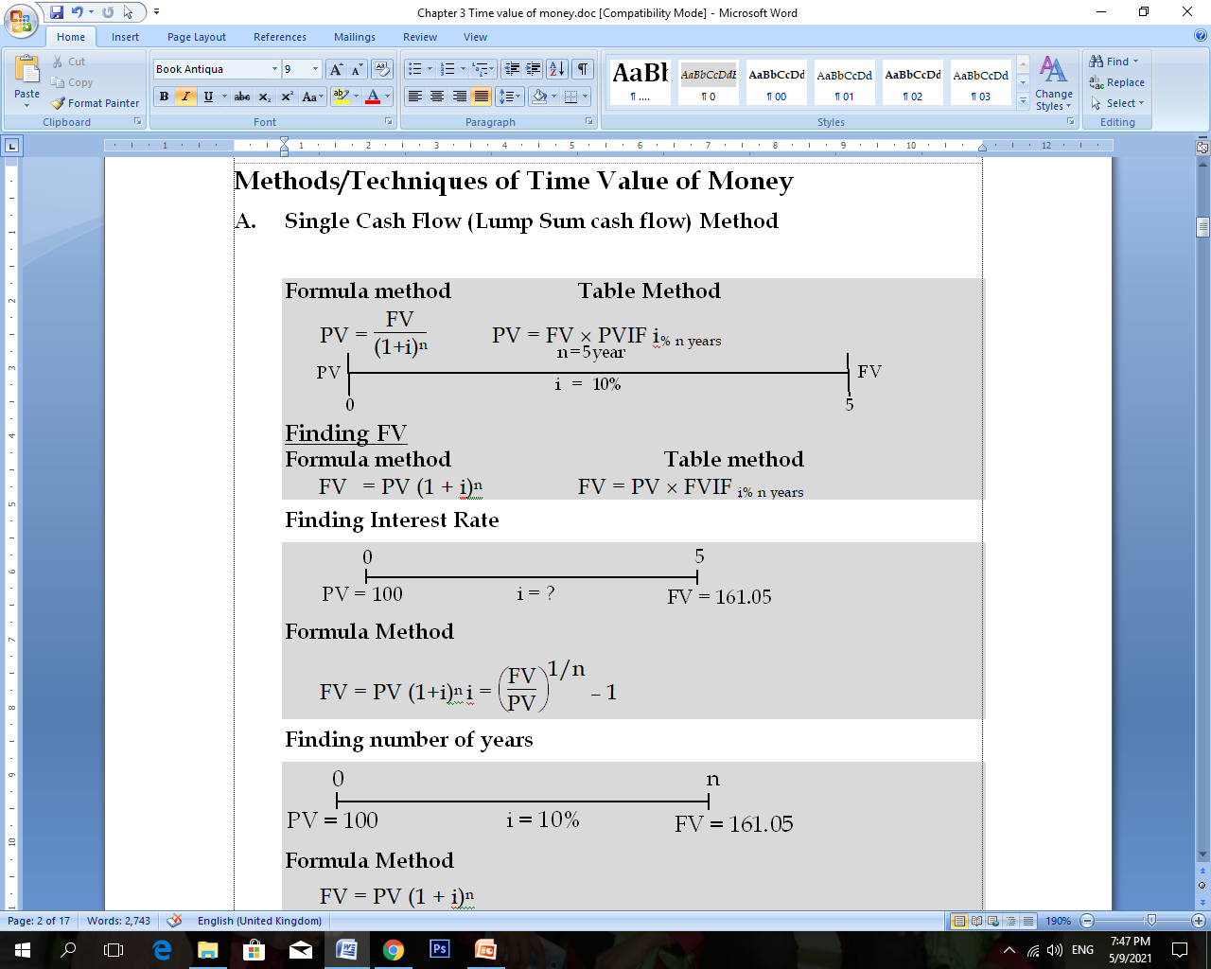
A. Single Cash Flow (Lump Sum cash flow) Method

Slide 8
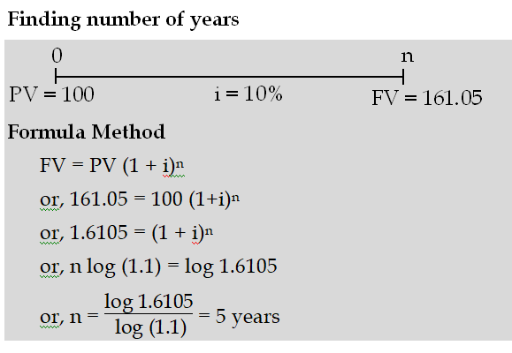

Slide 9
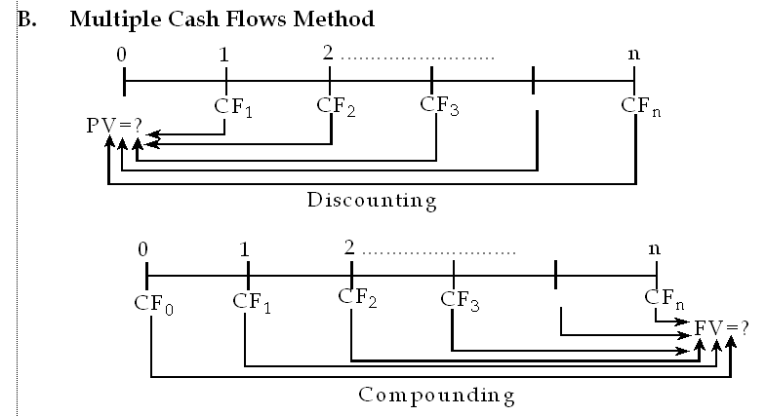
B. Multiple Cash Flows Method

Slide 10
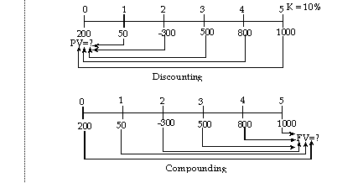
Uneven Cash Flows Method

Slide 11
Annuity
Annuity is a series of payment of equal amount at fixed intervals for a specified number of periods.
Equal monthly payment of loan and insurance premium are the examples of annuity.
Annuity is of two types : ordinary annuity and annuity due.
1. Ordinary annuity:-
An annuity whose payment occur at the end of each period is called ordinary annuity.
2. Annuity due:-
An annuity whose payment occur at the beginning of each period is called annuity due.

Slide 12
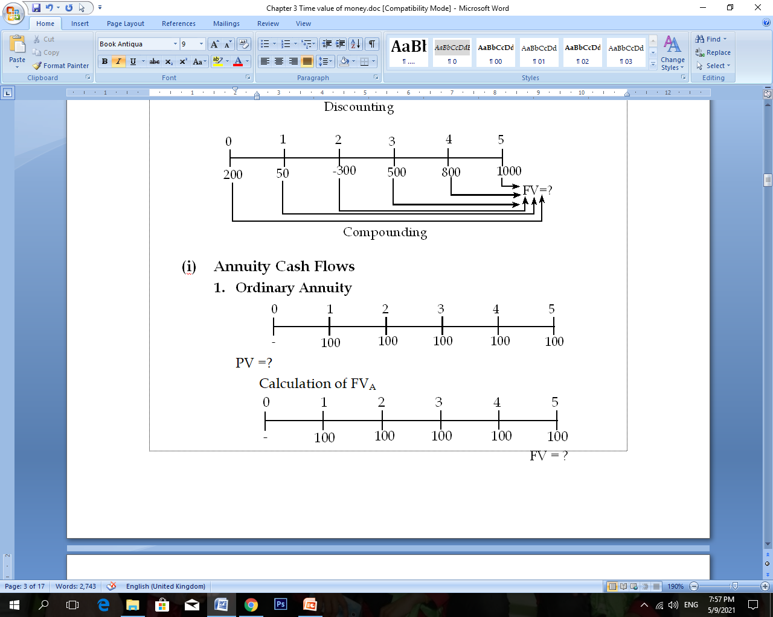

Slide 13
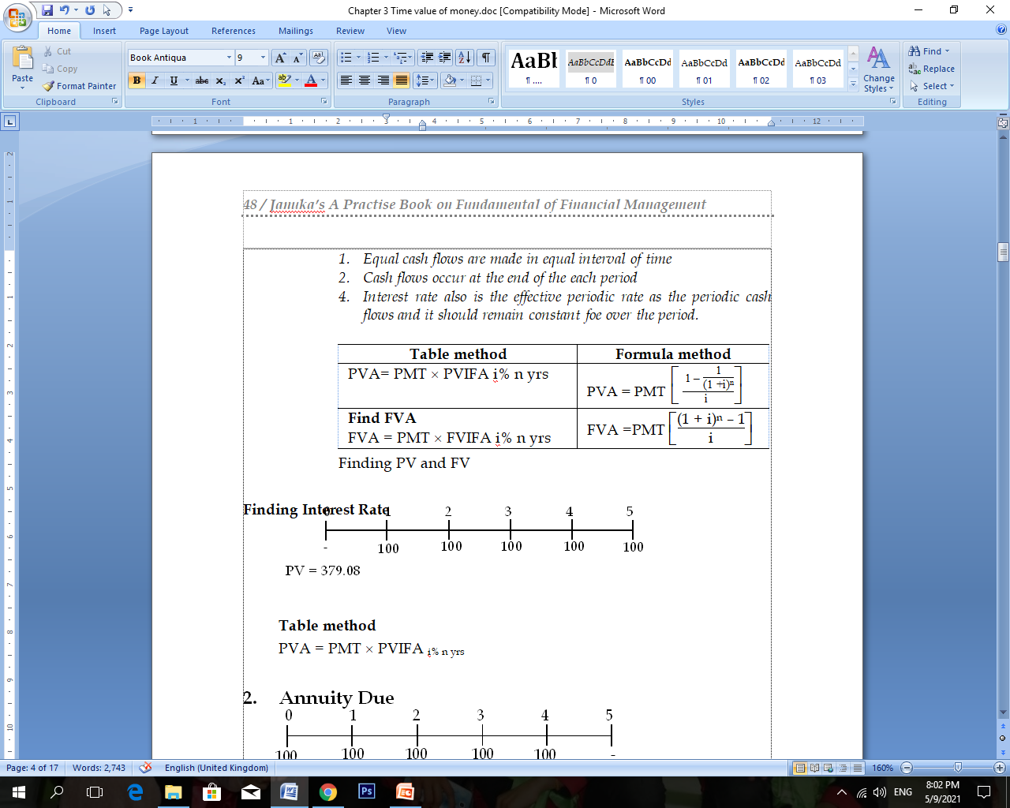
1. Equal cash flows are made in equal interval of time 2. Cash flows occur at the end of the each period 3. Interest rate also is the effective periodic rate as the periodic cash flows and it should remain constant for over the period

Slide 14
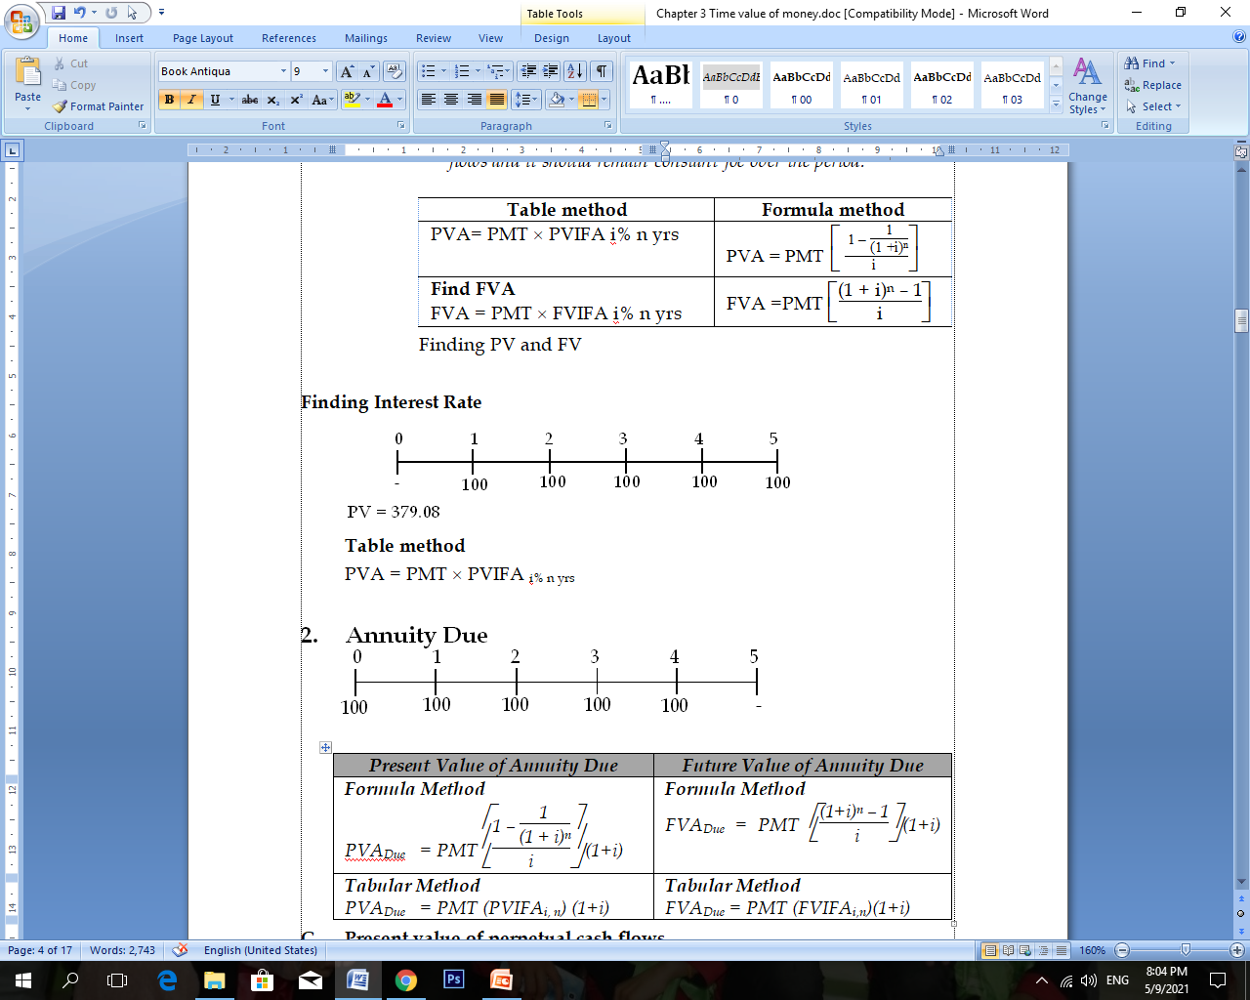

Slide 15
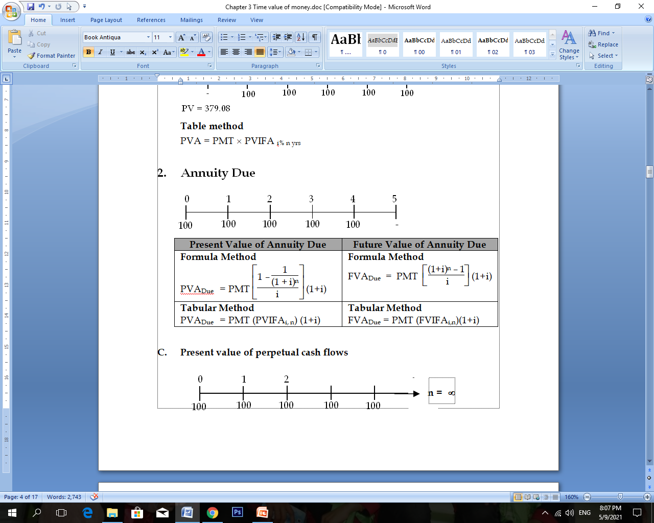
2. Annuity Due method

Slide 16
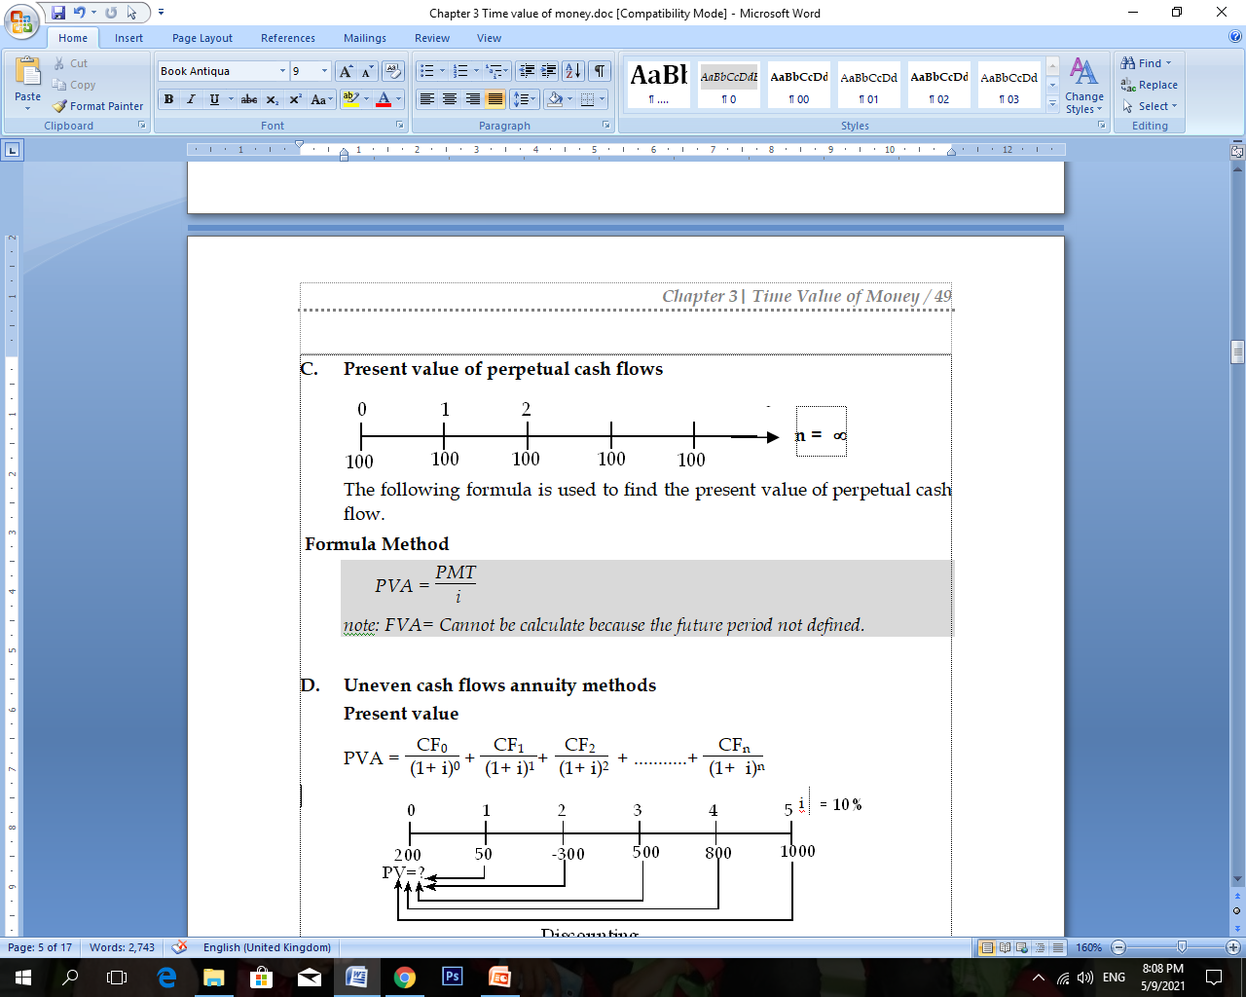
C. Present value of perpetual cash flows

Slide 17
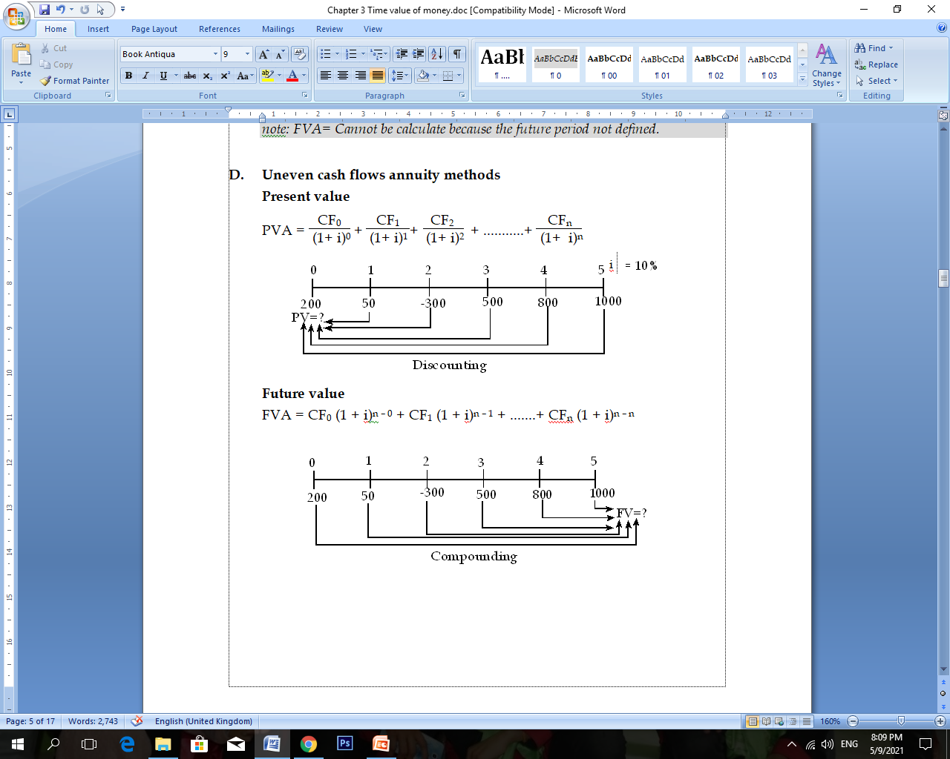
D. Uneven cash flows annuity methods

Slide 18
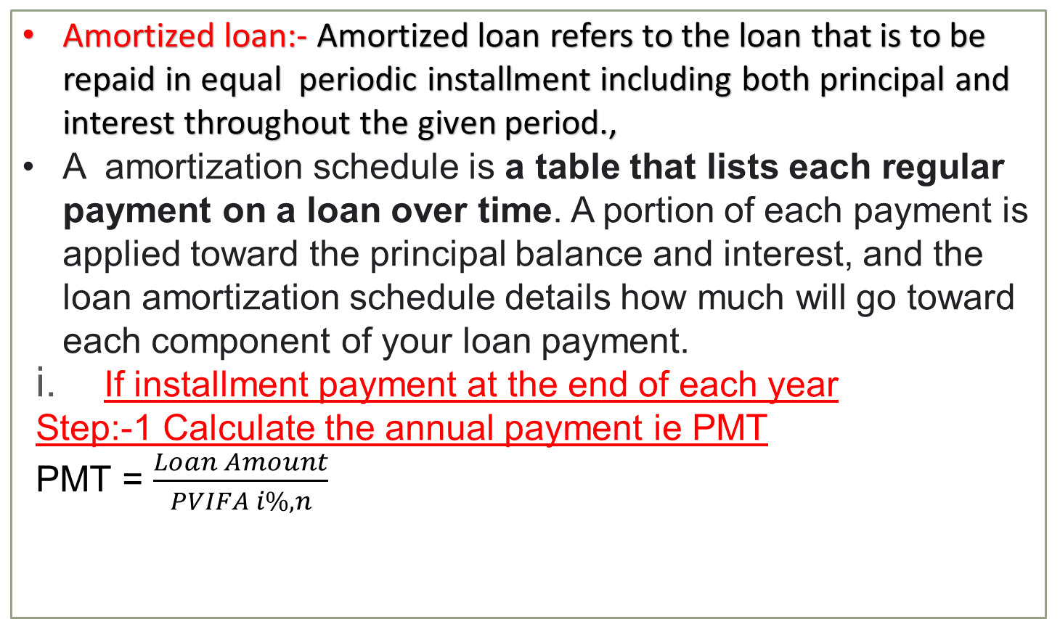
Amortization Loan Schedule
Amortized loan:- Amortized loan refers to the loan that is to be repaid in equal periodic installment including both principal and interest throughout the given period.,
A amortization schedule is a table that lists each regular payment on a loan over time. A portion of each payment is applied toward the principal balance and interest, and the loan amortization schedule details how much will go toward each component of your loan payment.
If installment payment at the end of each year
Step:-1 Calculate the annual payment ie PMT
PMT = $\frac{Loan Amount}{PVIFA i\%,n}$

Slide 19
Step 2:- Prepare loan amortization schedule
Year (1) | Beginning Balance (2) | PMT (3) | Interest (4) =(2) *i | Principal (5)= (3) – (4) | Ending Balance (6) = (2) –(5)
1 2 3 … …. n | ***** ***** ***** …... …… ****** | ****** ****** ****** ….. ….. ***** | ****** ****** ****** ….. ….. ***** | ****** ****** ****** ….. ….. ***** | ****** ****** ****** ….. ….. 0

Slide 20
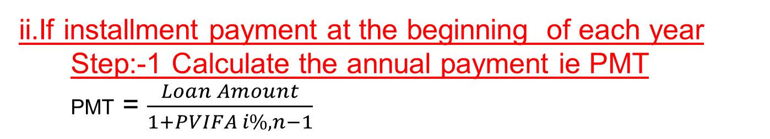
ii.If installment payment at the beginning of each year Step:-1 Calculate the annual payment ie PMT PMT = $\frac{Loan Amount}{1+PVIFA i\%,n−1}$
Step 2:- Prepare loan amortization schedule
Year (1) | Beginning Balance (2) | PMT (3) | Interest (4) =(2) *i | Principal (5)= (3) – (4) | Ending Balance (6) = (2) –(5)
0 1 2 3 … …. n-1 | ***** ***** ***** …... …… …… ****** | ***** ***** ***** …... …… …… ****** | 0 ***** ***** …... …… …… ****** | ***** ***** ***** …... …… ……. ****** | ***** ***** ***** …... …… …… 0

Slide 21
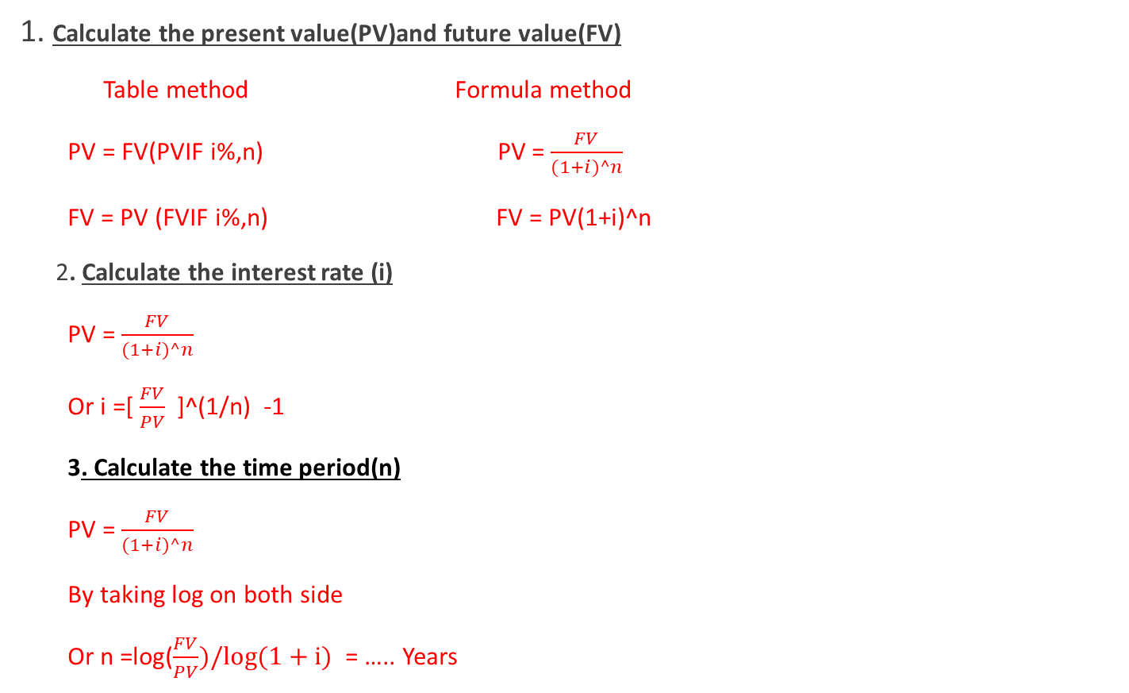
List of Formulas
1. Calculate the present value(PV)and future value(FV)
Table method Formula method
PV = FV(PVIF i%,n) PV = $\frac{FV}{(1+i)^n}$
FV = PV (FVIF i%,n) FV = PV(1+i)^n
2. Calculate the interest rate (i)
PV = $\frac{FV}{(1+i)^n}$
Or i =[ $\frac{FV}{PV}$ ]^(1/n) -1
3. Calculate the time period(n)
PV = $\frac{FV}{(1+i)^n}$
By taking log on both side
Or n =log($\frac{FV}{PV})/log(1+i)$ = ….. Years

Slide 22
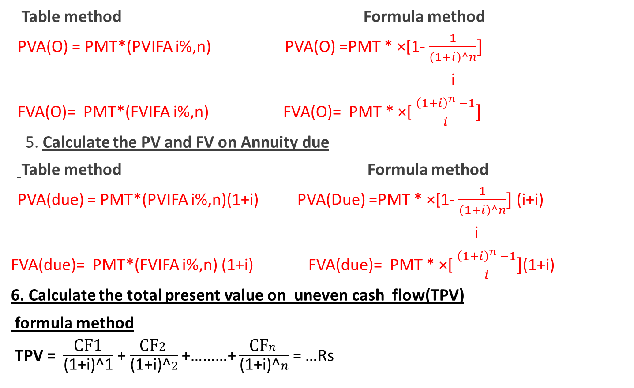
4. Calculate the PV and FV on ordinary Annuity
Table method Formula method
PVA(O) = PMT*(PVIFA i%,n) PVA(O) =PMT * ×[1- $\frac{1}{(1+i)^n}]$
i
FVA(O)= PMT*(FVIFA i%,n) FVA(O)= PMT * ×[ $\frac{{\left(1+i\right)}^{n} −1}{i}]$
5. Calculate the PV and FV on Annuity due
Table method Formula method
PVA(due) = PMT*(PVIFA i%,n)(1+i) PVA(Due) =PMT * ×[1- $\frac{1}{(1+i)^n}]$ (i+i)
i
FVA(due)= PMT*(FVIFA i%,n) (1+i) FVA(due)= PMT * ×[ $\frac{{\left(1+i\right)}^{n} −1}{i}]$(1+i)
6. Calculate the total present value on uneven cash flow(TPV)
formula method
TPV = $\frac{\text{CF}\text{1}}{\text{(}\text{1}\text{+}\text{i}\text{)^}\text{1}}$ + $\frac{\text{CF}2}{\text{(}\text{1}\text{+}\text{i}\text{)}\text{^}2}$ +………+ $\frac{\text{CF}n}{\text{(}\text{1}\text{+}\text{i}\text{)}\text{^}n}$ = …Rs

Slide 23
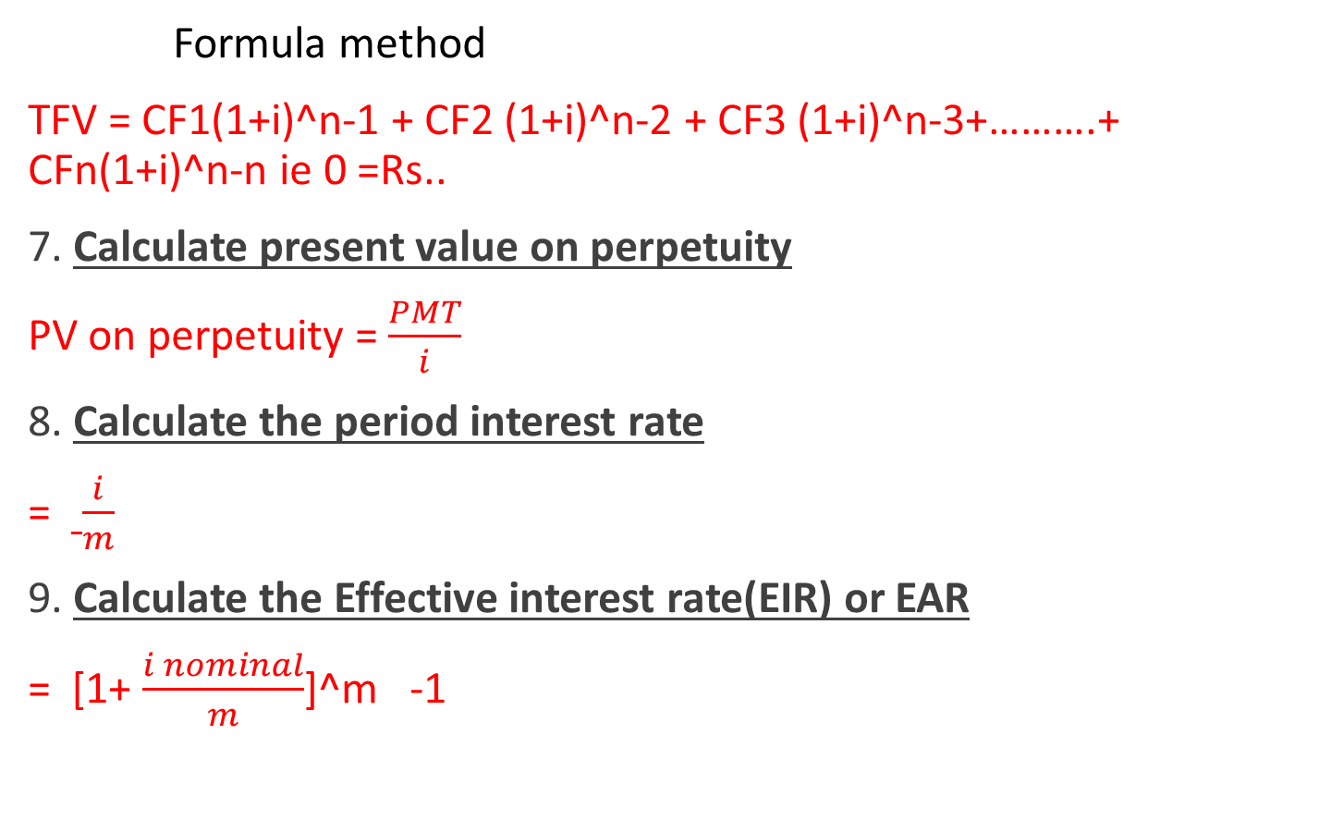
6. Calculate the Total future value on uneven cash flow
Formula method
TFV = CF1(1+i)^n-1 + CF2 (1+i)^n-2 + CF3 (1+i)^n-3+……….+ CFn(1+i)^n-n ie 0 =Rs..
7. Calculate present value on perpetuity
PV on perpetuity = $\frac{PMT}{i}$
8. Calculate the period interest rate
= $\frac{i}{m}$
9. Calculate the Effective interest rate(EIR) or EAR
= [1+ $\frac{i nominal}{m}$]^m -1

Slide 24
Where,
PV = present value ie (deposit/lend/ borrowed/ initial value)
FV = future value i.e( expected/ year end/ accumulated value)
i= Annual interest rate/ nominal rate/ discount rate/ appropriate rate
n= Time period
PMT = payment amount (ie per year ,each year, each month etc)
M= number of compounding period in year
If semi annual compounding (m) =2, if monthly compounding (m) = 12,quarterly compounding(m)=4
Daily compounding(m) = 360 or 365

Slide 25
Best of luck
THE END

